Slide 1

Financial Dashboard using PYTHON with Yahoo Finance Submitted to: PHAN Minh
Submitted By:
NITHARWAL Ashwani
ashwani.nitharwal@ieseg.fr

Slide 2
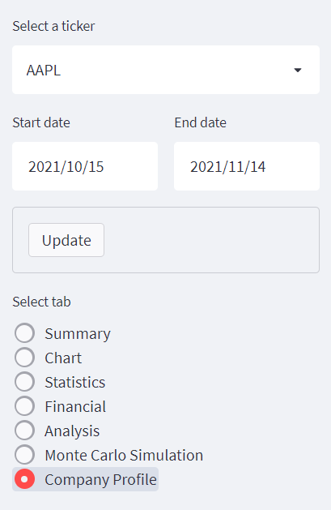
Sidebar
Select a company or finance from list
Select start date and end date for analysis
Update button to refresh the data and page
Select a tab from the list of radio buttons of tabs
si.tickers_sp500() to get list of available stocks

Slide 3
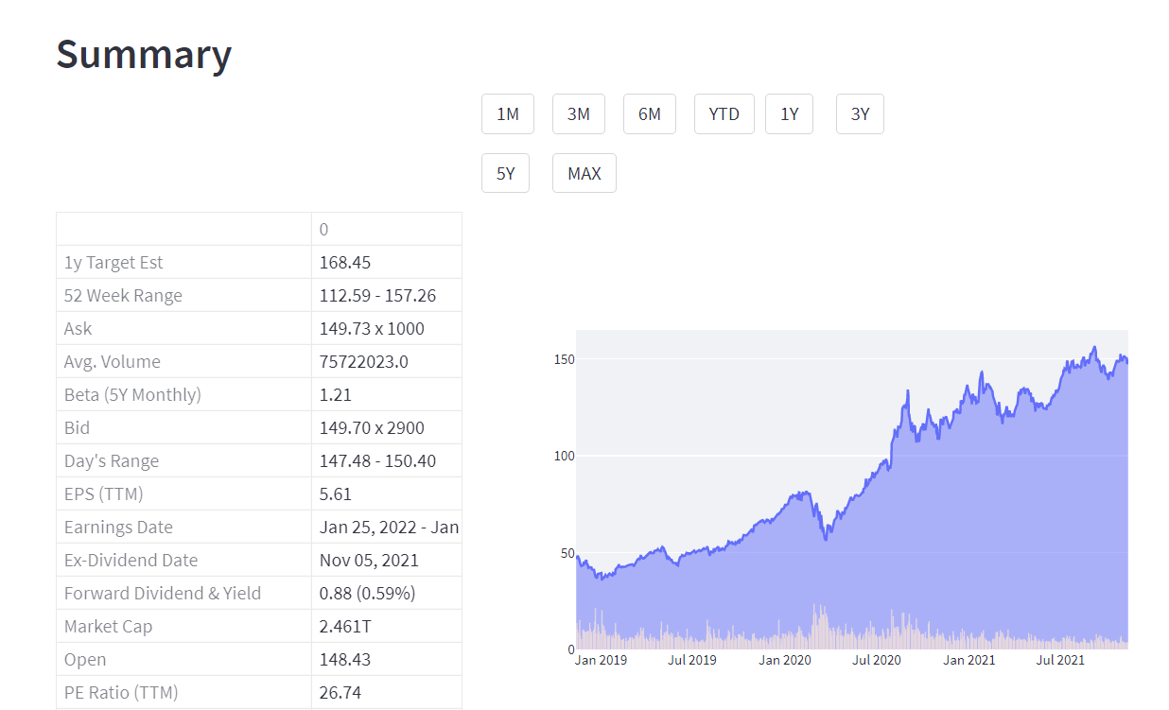
Tab 1 - Summary
si.get_quote_table() function to retrieve data from yahoo finance
If else conditions to know how the user wants to see the data
Buttons to select the interval of chart data representations
Plotly library to plot area chart with volume bars on it
To retrieve and present data in dataFrame form and then by streamlit
Interactive chart to hover and see the values plotted
yf.download(tickers = ticker,period = "3y") to get data for selected ticker of 3 months
Plotly subplots, add_trace() to add multiple factors to the same chart

Slide 4
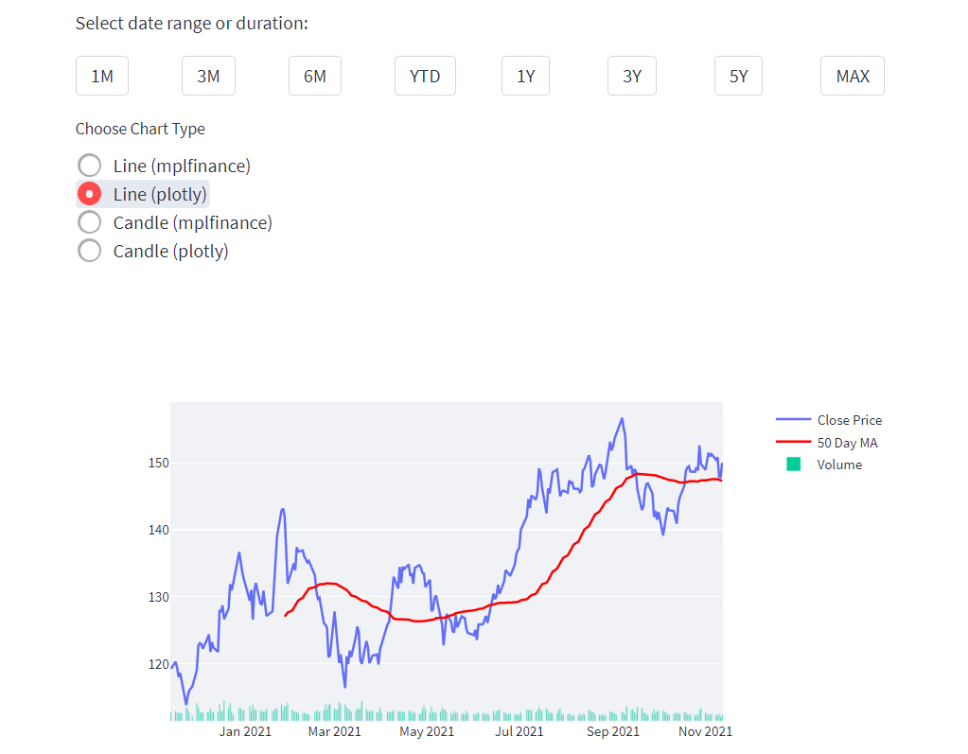
Tab 2 - Chart
si.get_data() function to retrieve data from yahoo finance
Dropdowns to choos the start and end dates for the chart
Selecting the intervals to show data
Selecting the default durations like 1M, 3M, YTD, 5Y, etc
Choice of Line/Candle chart from mplfinance library and Line/Candle chart from plotly library
Interactive charts to hover and see the values using plotly subplots and add_trace()
Volume integrated charts
Shows Moving Average (MA) for 50 days

Slide 5
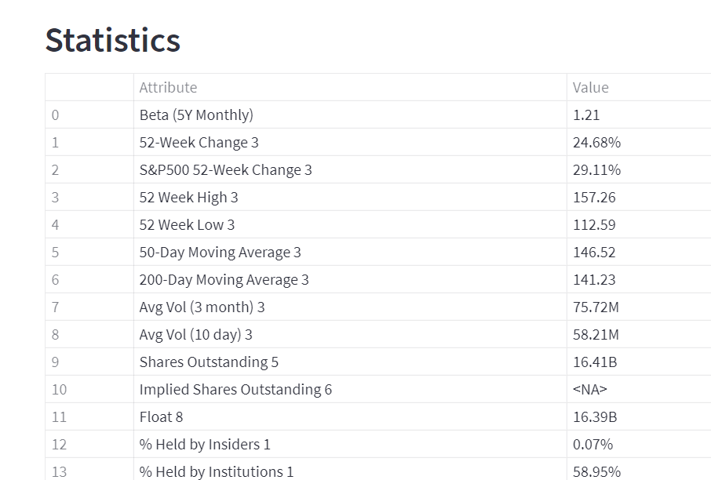
Tab 3 - Statistics
si.get_stats() function to retrieve data yahoo finance
Retrieving data and presenting it by streamlit
Al the Statistics related information is presented in this table

Slide 6
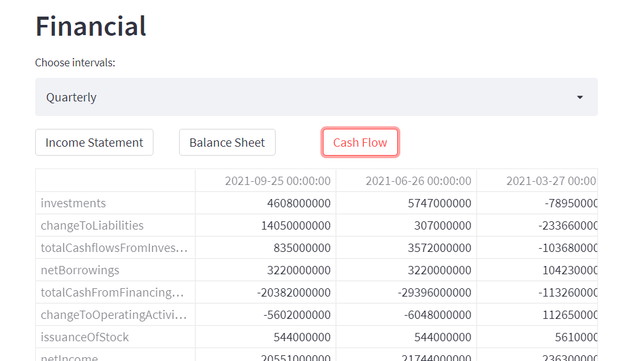
Tab 4 - Financials
Financials consists of three types of data: Income Statement, Cash Flow, Balance Sheet
si.get_income_statement(), si.get_cash_flow(), si.get_balance_sheet() to get the relevant data
Choice to select the intervals to show data : Annually or Quarterly
Choice to select the data among the above 3 categories
Data retrieved and presented into streamlit for analysis of financials

Slide 7
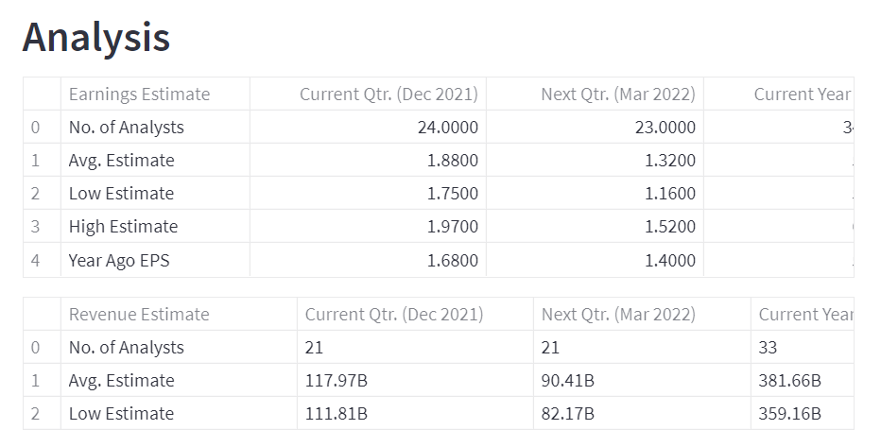
Tab 5 - Analysis
si.get_analysts_info() function to retrieve data from yahoo finance
Different divisions based on the category like Earnings Estimate, Revenue Estimate, Earnings History, etc
All the figures to analyze company’s progress

Slide 8
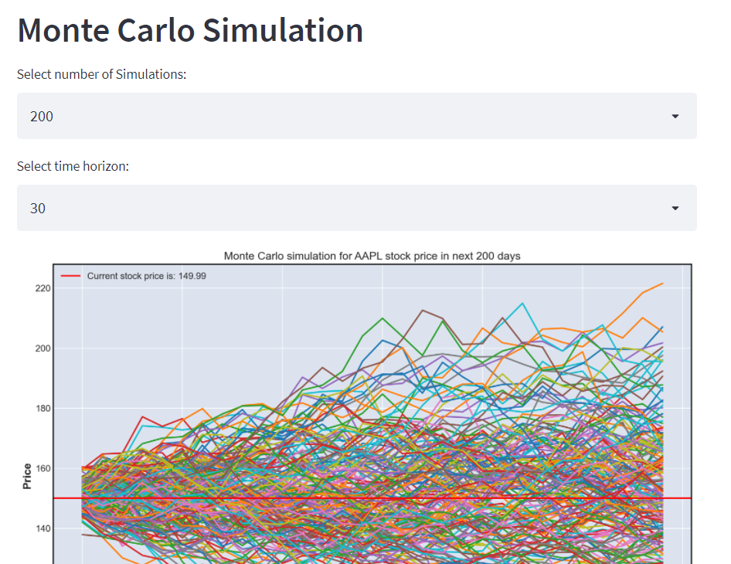
Tab 6 – Monte Carlo Simulation
si.get_data() function to get data
Manipulating data using pandas, numpy and other functions to prepare data
Select number of simulations
Select time horizon
Plotting the curve using pyplot
Finding VaR Value at Risk

Slide 9
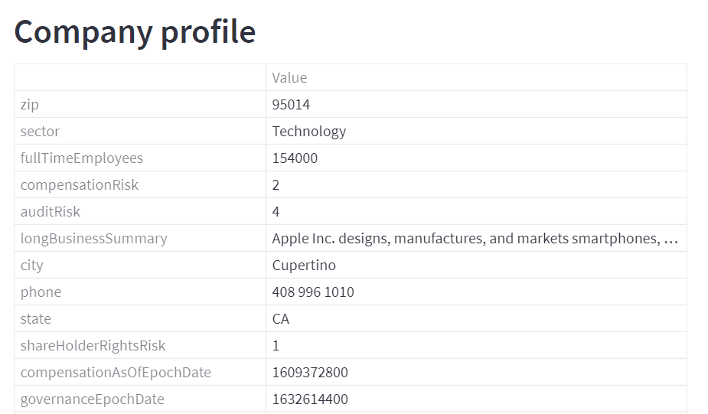
Tab 7 – Company Profile
si.get_company_info() to get data
Provides basic Company Profile
General facts and information about the company

Slide 10

Libraries with their sub-libraries
pandas
matplotlib.pyplot
yahoo_fin
streamlit
datetime, timedelta
numpy
mplfinance
yfinance
plotly

Slide 11

References
Plotly documentation - https://plotly.com/python
Matplotlib documentation - https://matplotlib.org/
Class Illustrations and Jupyter notebooks
Stackoverflow - https://stackoverflow.com/
Google for very basic keys shortcuts
Mplfinance - https://github.com/matplotlib/mplfinance
Streamlit - https://streamlit.io/

